Slide 1
SUHA – Metric Framework Bridge
A guided experience to SUHA onboarding
- Rangavajjala Durga Prasad(NOW)

Slide 2
Metrics Framework (MF)
Metrics Framework is a set of APIs and defined table schemas, designed to capture the metrics like performance, error, execution stats, etc. for an application
How to leverage MF:
Extend MF base tables to store metrics
Extend MF Script Includes
Instrument code with MF APIs

Slide 3
SUHA and its Services to ServiceNow
SUHA - Service Usage And Health Analytics
SUHA is all about graphical representation of services to track the health and other metrics based as user required.
Inputs to onboard to SUHA:
User should create a service for his application , should have a data source , and need to create metrics, group metric definitions.
Output of SUHA:
With all the metrics and group metrics information, user will be redirected to the dashboard where he can track his metric services.

Slide 4
SUHA Onboarding Process
SUHA onboarding includes creation of
Data Source
Group/Service
Metric
Group Metric Definitions (includes scripting)
Analyzing breakdowns

Slide 5
What MF - SUHA Bridge solves ?
Provides a visualization layer for MF
A Guided experience to onboard meaningful metrics to SUHA
Auto-populated defaults with minimum inputs from the user
Reduce onboarding time from 4 days -> 1 hour, also ensuring meaningful definitions

Slide 6
Design Philosophy
Auto-populated defaults
Guided user experience
Minimum user configuration
Work breakdown in 4 deliverable phases
Build reusable and decoupled components that can be leveraged to develop more SUHA integration bridges in future

Slide 7
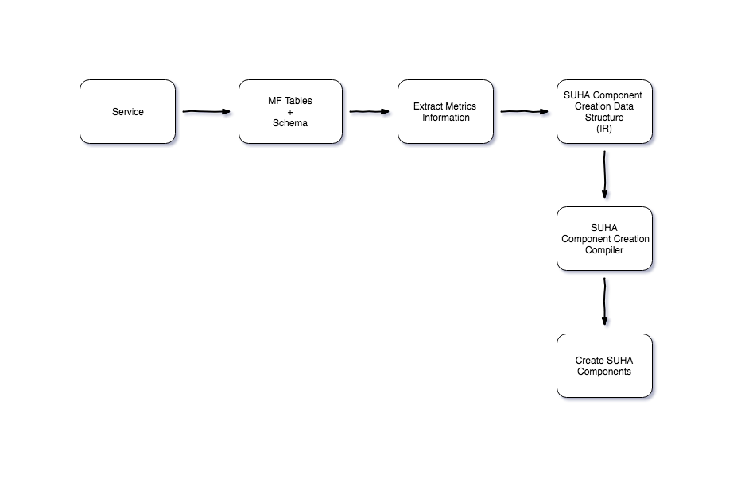
Design Deep-Dive (Core Backend)

Slide 8
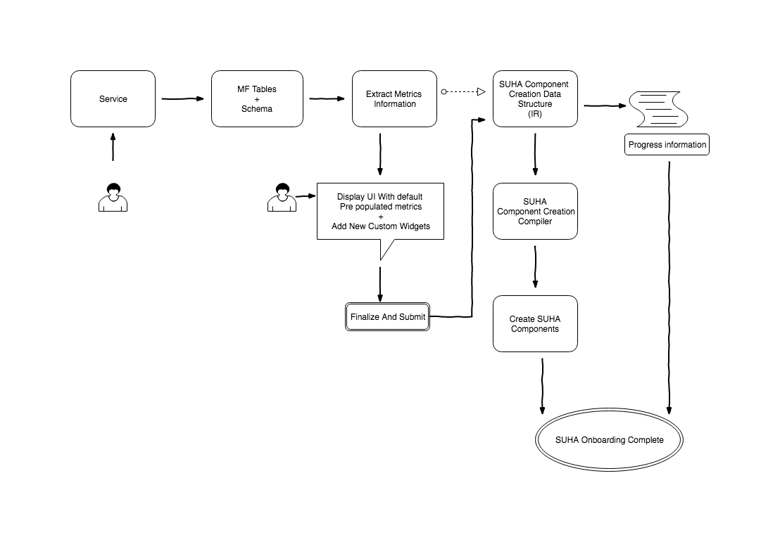
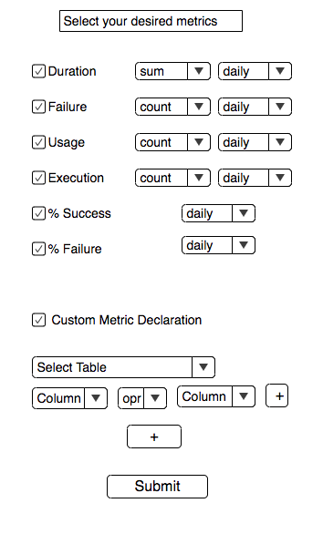
Design Summary

Slide 9
Timelines
Phase 1:(24-April to 5-May)
Phase 2:(6-May to 21-May)
Phase 3:(22-May to 17 Jun)
Adding Service and Group details to SUHA Group table
Loading all Metrics Framework tables from given scope or Global scope as per user inputs
Data Structure to represent predefined metrics definitions
Demo-1 : 6-May-2019
Outcome : MF-SUHA bridge is ready with all predefined metrices data representation to populate on UI for end user to view/edit
UI to view/edit all predefined metrics with options to customize (based on the need).
Process user inputs, prepare intermediate representation for SUHA component creation
SUHA component creator
Demo-2 : 22-May-2019
Outcome : Bridge is ready with all required SUHA components for standard metric definitions
%Health Metric analysis and onboarding
Ability to onboard custom metrics
Progress view with live tracking of SUHA component creation
Ability to detect duplicate definition getting onboarded
Demo-3 : 17-Jun-2019
Outcome : Bridge capable of onboarding of standard/custom definitions, % health definition with progress bar
Final Demo on 26-Jun-2019

Slide 10
Questions?
.

Slide 11
Thank you
For your valuable time

